Slide 1
NEXT GEN
CORP.
PRESENTED BY
ADELANWA OGUNLOLU

Slide 2
Table of contents
01
02
03
Employee
Retention Analysis
Performance
Analysis
Buisness Overview
04
05
Conclusions
Salary Analysis
2

Slide 3
01
Buisness Overview
3

Slide 4
Overview
Next Gen Corp is a rapidly growing technology company that specializes in creating
cutting edge hardware and software solutions. In order to ensure expansion, the
organization takes pride in luring top talents across the globe, and upholding excellent
employee satisfaction.
Problem Statement
There are growing concerns about employee turnover, salary disparities and
performance variability within departments.
Solutions?
•
Analyse employee turnover trends and identify root causes of high turnover rates
•
Analyse employee performance across different departments and identify areas
where performance can be improved
•
Analyse salary distribution and ensure fair compensation on performance and
departmental benchmarks.
4

Slide 5
02
Employee
Retention Analysis
5

Slide 6
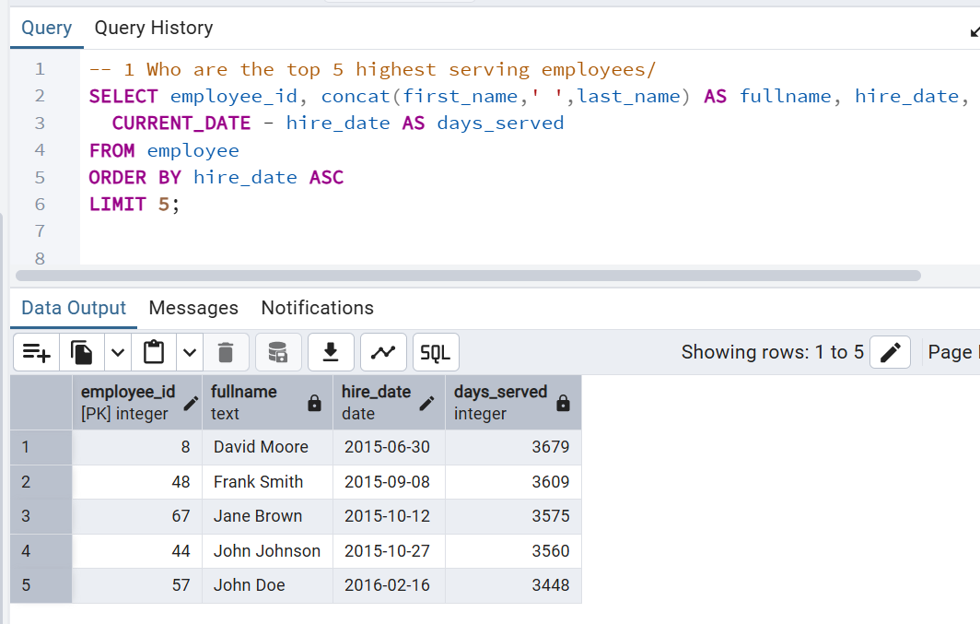
1. Who are the top 5 highest serving
employees?
Insights
Findings
• Top 5 employees are David Moore, Frank Smith, Jane
Brown, John Johnson, and John Doe.
• All top 5 employees have been employed for over 9
years, with David Moore as the longest serving
employee at 10 years.
• Majority of long staying employees were hired between
2015 and 2016
Actionable recommendations
• Conduct comprehensive stay interviews to determine
key drivers for loyalty to replicate across the
organisation
• Analyse the 2015-2016 hiring process
• Continuous monitoring of top staying employees.
6

Slide 7
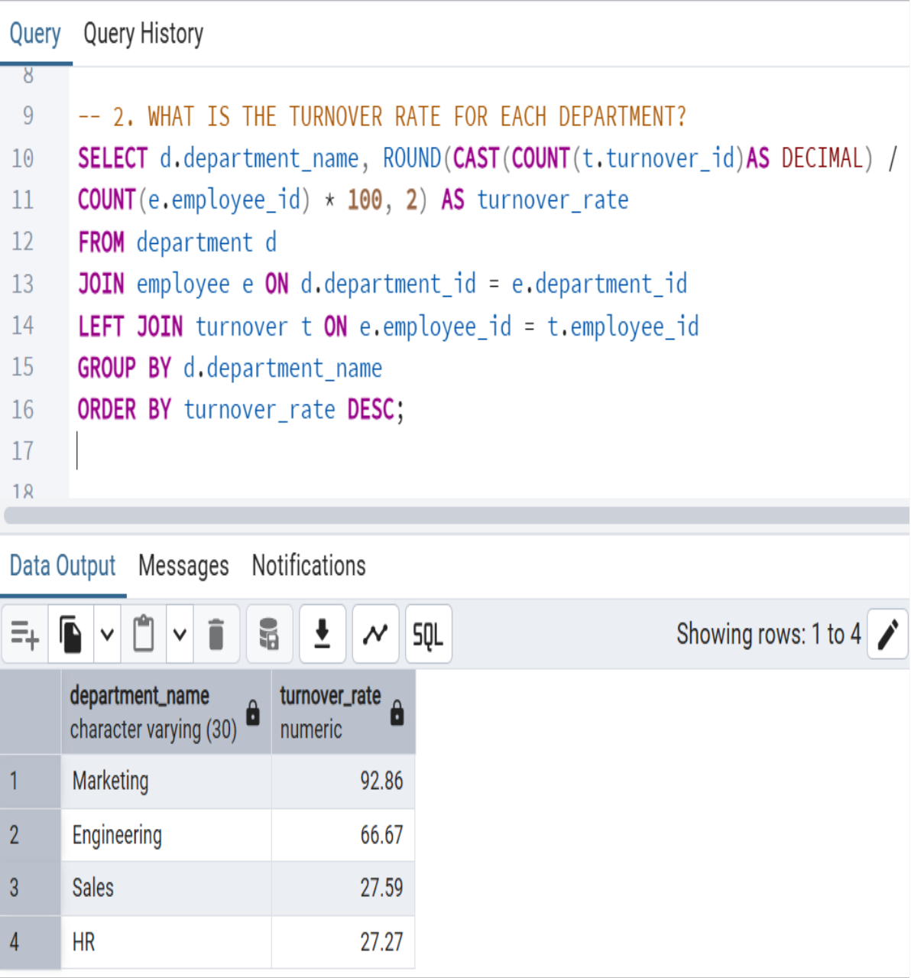
2. What is the turnover rate for each
department?
Insights
Findings
• Marketing (92.86%) and Engineering (66.67%) have
alarmingly high turnover rates, indicating severe
underlying problems.
• Stark contrast between high turnover departments and
stable ones (Sales, 27.59% and HR, 27.27%), suggesting
localized issues
• Marketing's turnover is nearly 1.5x Engineering’s and 3x
Sales/HR.
Actionable Recommendations
• Deep-dive root cause analysis i.e conduct exit/stay
interviews and surveys, etc
• Targeted retention strategies in low turnover departments
i.e career pathing, competitive compensation, improved
work-life balance and recognition programs
• Best practise transfer; Cross departmental workshops,
mentorship programs and policy review from Sale/HR
7

Slide 8
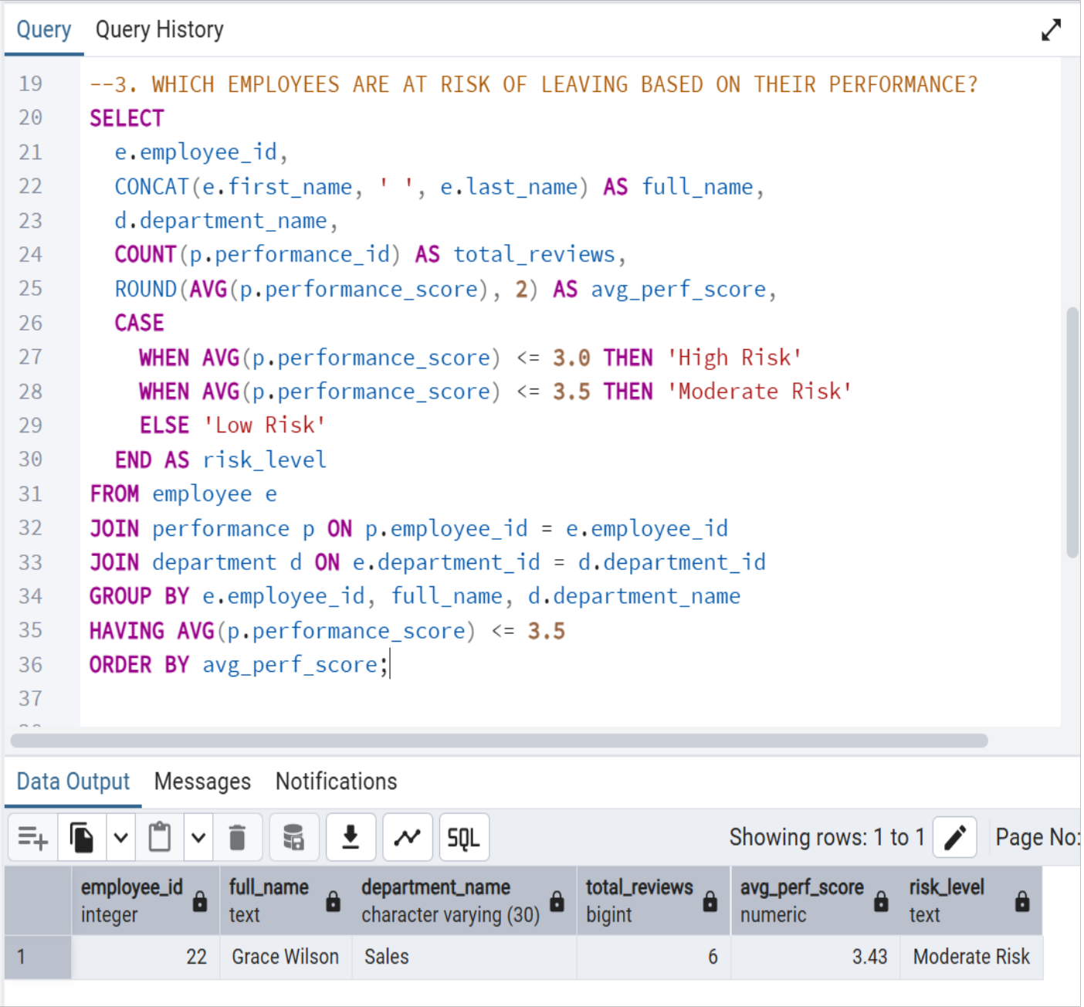
3. Which employees are at risk of leaving
based on their performance?
Insights
Findings
• Grace Wilson in Sales is the only employee with a
moderate risk of leaving the company.
• She has an average performance score of 3.43
Actionable recommendations
• Managerial check-in
• Performance improvement plans (PIP)
• Focused mentorship plans
8

Slide 9
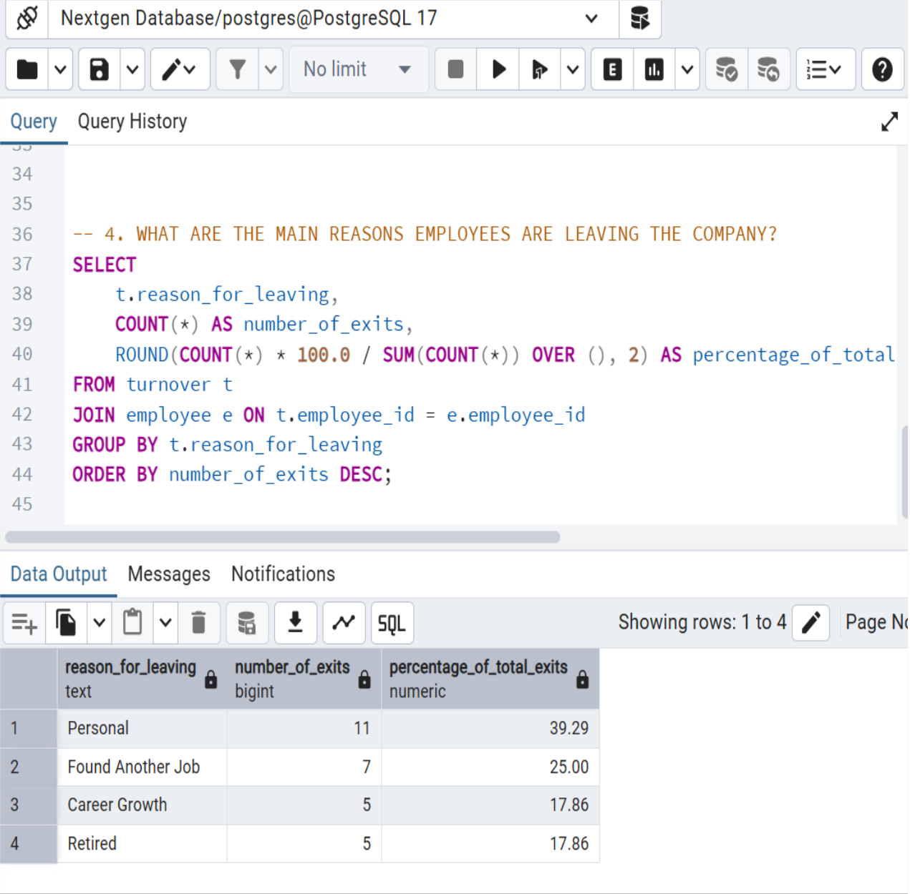
4. What are the main reasons employees are
leaving the company?
Insights
Findings
• ‘Personal’ reasons accounts for the largest proportion of
exits (39.29%).
• ‘Found another Job’ (25%) highlights external market
influence and company competitiveness in talent
retention.
• ‘Career growth’ (17.86%) indicates potential gaps in
internal advancement opportunities
Actionable Recommendations
• Deep-dive into ‘Personal’ reasons for leaving, by
conducting enhanced exit interviews
• Provide regular compensation/benefits review, career
development opportunities and recognition programs
• Conduct regular pulse surveys, HR analytics
dashboards and manager training on retention
• Cultivate a positive work environment
9

Slide 10
03
Performance
Analysis
10

Slide 11
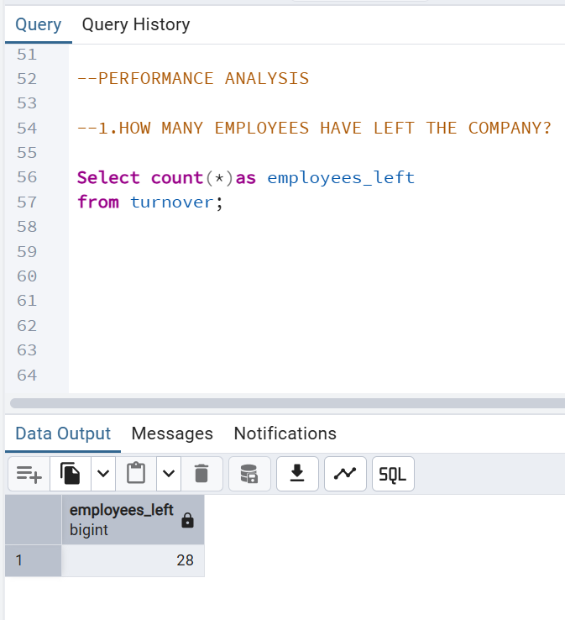
1. How many employees have left the
company?
Insights
Findings
• 28 out of 60 employees have left the company
Actionable Recommendations
• Root cause analysis i.e conduct exit/stay interviews
and surveys, etc
• Targeted retention strategies in low turnover
departments i.e career pathing, competitive
compensation, improved work-life balance and
recognition programs
• Conduct comprehensive stay interviews to
determine key drivers for loyalty to replicate across
the organisation
11

Slide 12
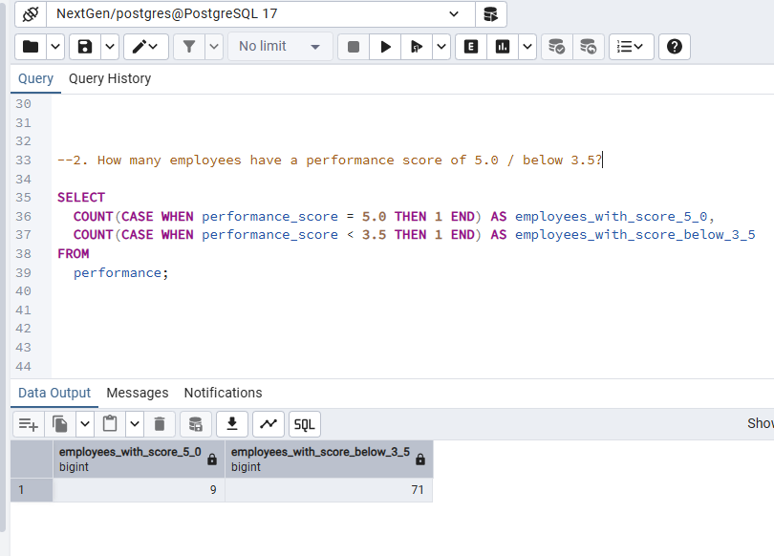
2. How many employees have a performance
score of 5.0/ below 3.5?
Insights
Findings
• Total of 7 employees have a performance score of 5.0
• Total of 71 employees with score below 3.5
Actionable Recommendations
The number of employees with a perfect score (5.0) can highlight top performers who may be candidates for promotion, special projects, or recognition programs.
The number of employees with a low score (below 3.5) signals potential issues that need to be addressed. This could point to the need for targeted training, performance improvement plans, or further investigation into underlying challenges they might be facing.
12

Slide 13
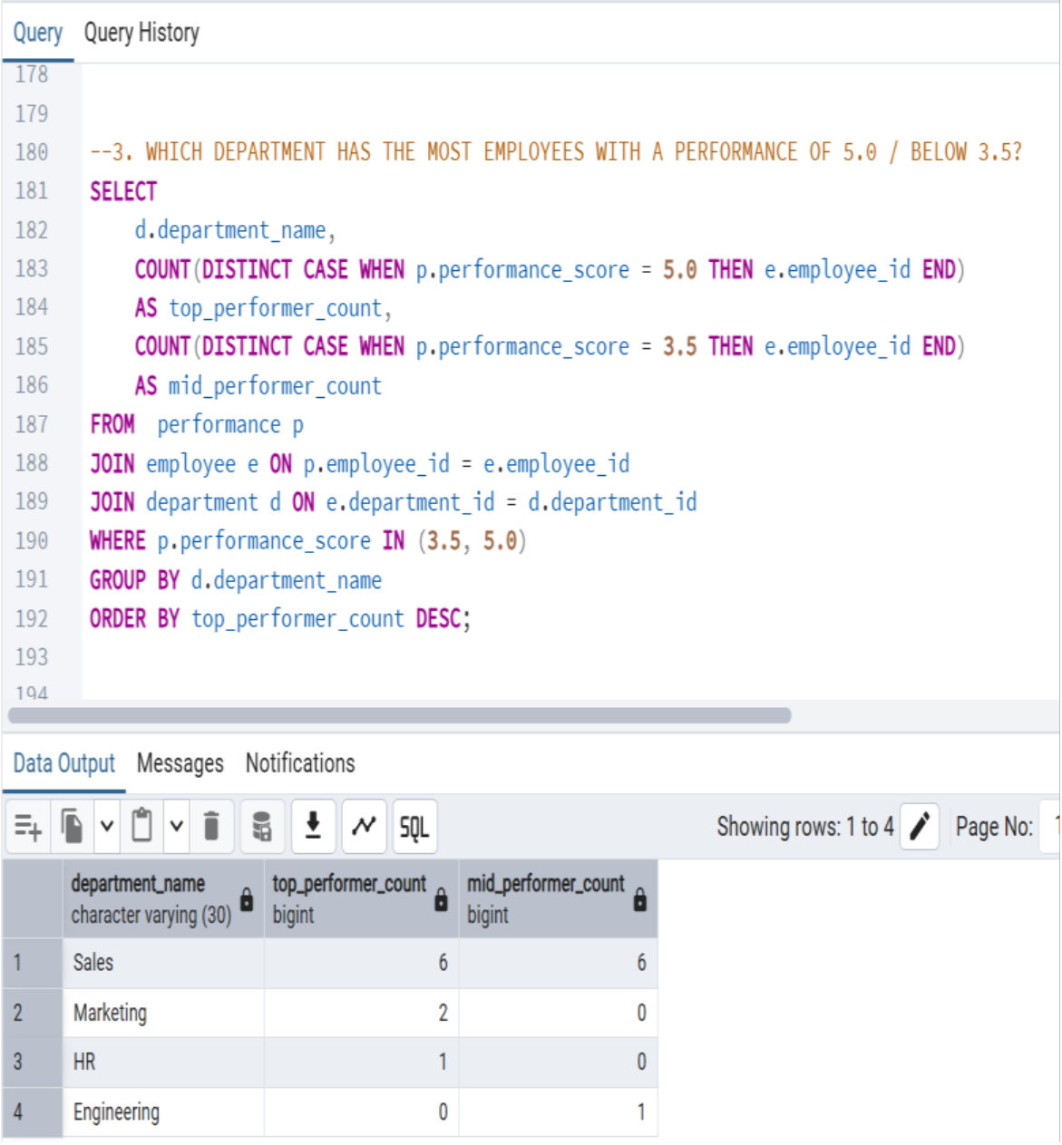
3. Which department has the most employeess
with a performance of 5.0/ below 3.5?
Insights
Findings
• Sales department has the highest number of employees
scoring 5.0 at 6, and lowest number of employees below
3.5, also at 6
• Marketing has 2 employees scoring 5.0, followed by HR
with 1 employee
• Most departments have no or few mid performers, implying
a generally high-performing organization
Actionable Recommendations
• Conduct detailed employee interviews to determine the
root cause of high mid performers in sales department
• Immediate intervention is needed on employees in the
sales department with mid performance score
• Conduct regular performance data reviews, in order to
generate early warning systems and provide
management training on early intervention
13

Slide 14
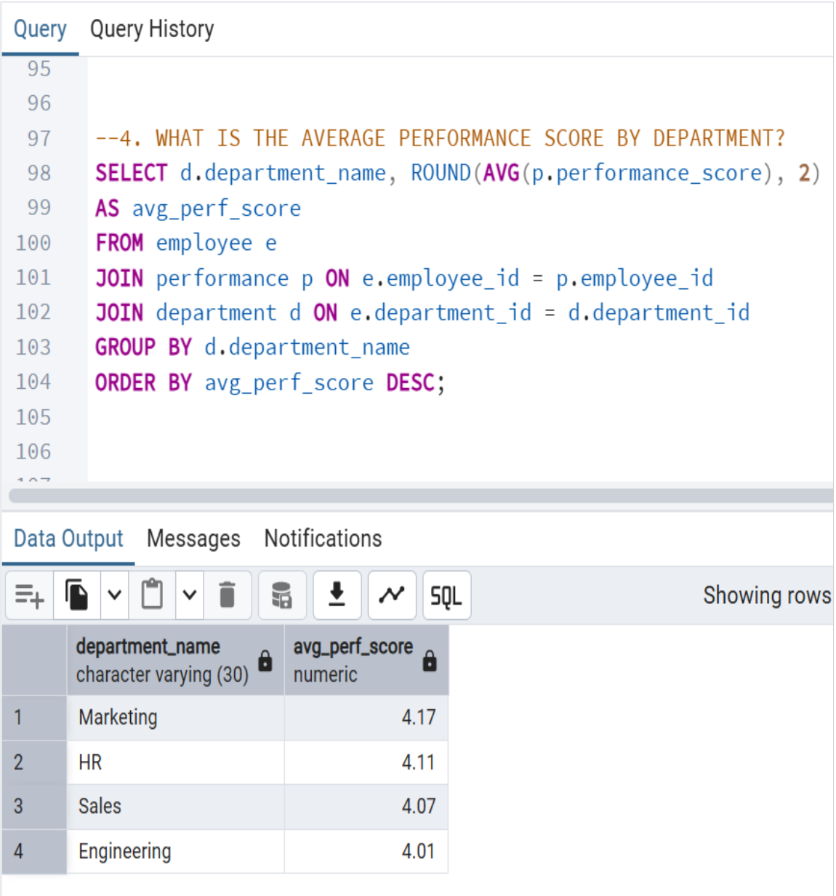
4. What is the average performance score by
department?
Insights
Findings
• All departments show high average performance scores
indicating a generally high-performing workforce
• Marketing has the highest average score (4.17), setting a
benchmark for excellence
• Engineering has the lowest score (4.01), suggesting areas
for targeted support
• There is very small difference in performance range (4.01 to
4.17) across all 4 departments
Actionable Recommendations
• Sustain and leverage high performance from Marketing
and HR through best practice sharing, leadership
development and internal/ cross departmental
benchmarking
• Conduct targeted performance enhancement through
needs assessments, tailored skill development,
performance coaching and resource optimization
14

Slide 15
04
Salary Analysis
15

Slide 16
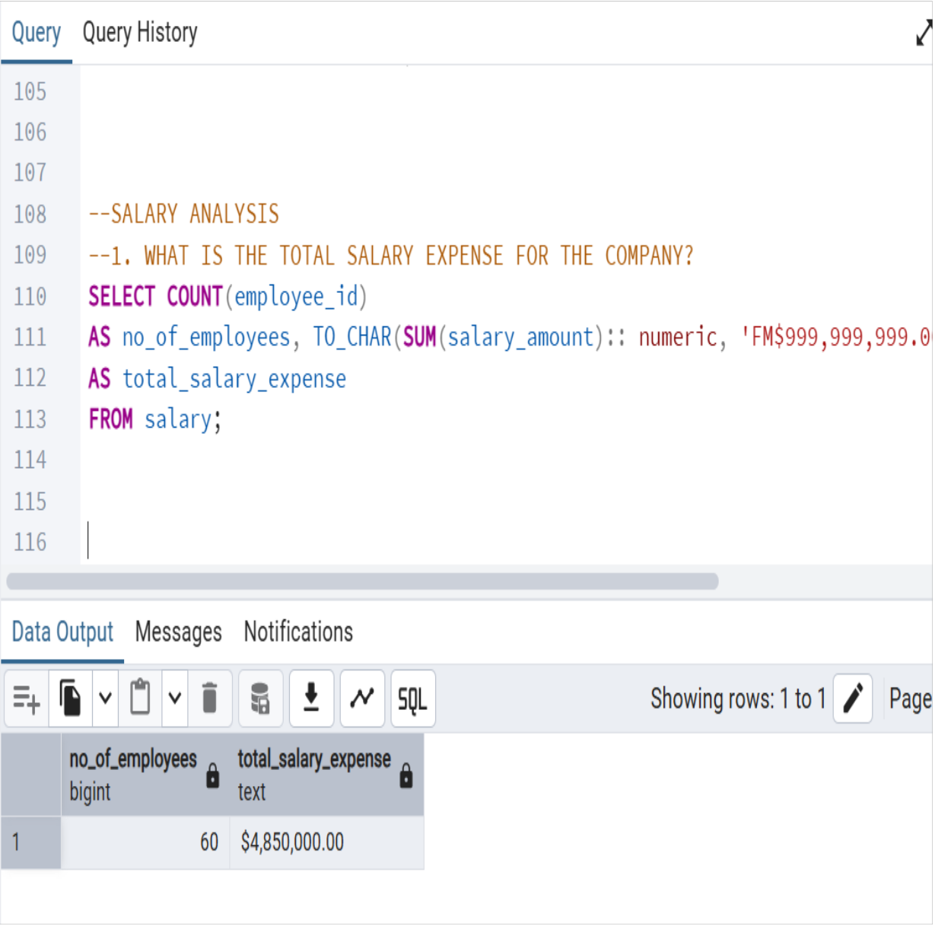
1. What is the total salary expense for the
company?
Insights
Finding
s
• Total annual salary expense of $4,850,000 for 60
employees represents a substantial investment
• Average salary per employee of $80,833.33 suggests a
competitive compensation level
Actionable Recommendations
• Perform a detailed breakdown of sales compensation,
career pathing, and their alignment with business
goals
• Perform a comprehensive compensation review on
marketing specialists
• Establish compensation bands and framework (eg. job
grading)
16

Slide 17
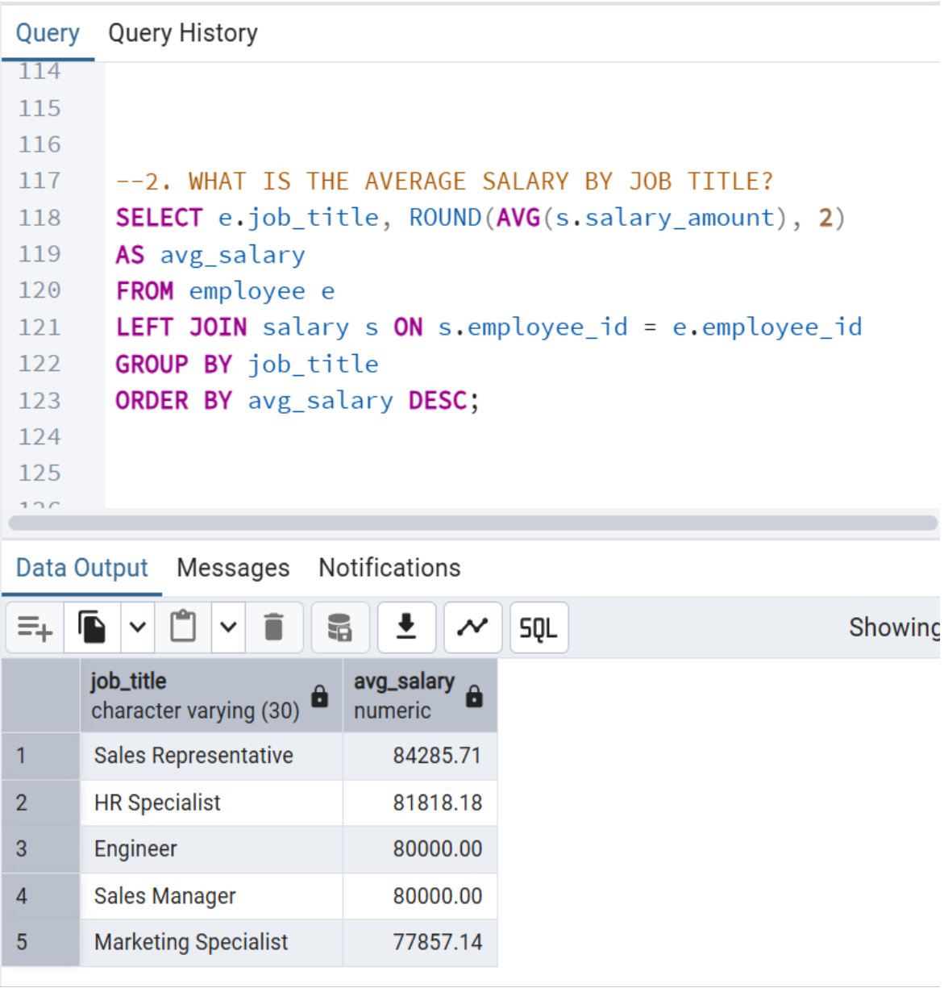
2. What is the average salary by job
title?
Insights
Finding
s
• Sales related roles (Sales reps and managers) have the highest
average salaries
• Sales reps have higher average salary than sales managers
• HR specialists have the second highest average salary (81,818)
• Marketing Specialists have the lowest average salary(77,857)
• Engineers and sales managers have identical average salary
(80,000)
Actionable Recommendations
• Perform a detailed breakdown of sales compensation,
career pathing, and their alignment with business goals
• Perform a comprehensive compensation review on
marketing specialists
• Establish compensation bands and framework (eg. job
grading)
17

Slide 18
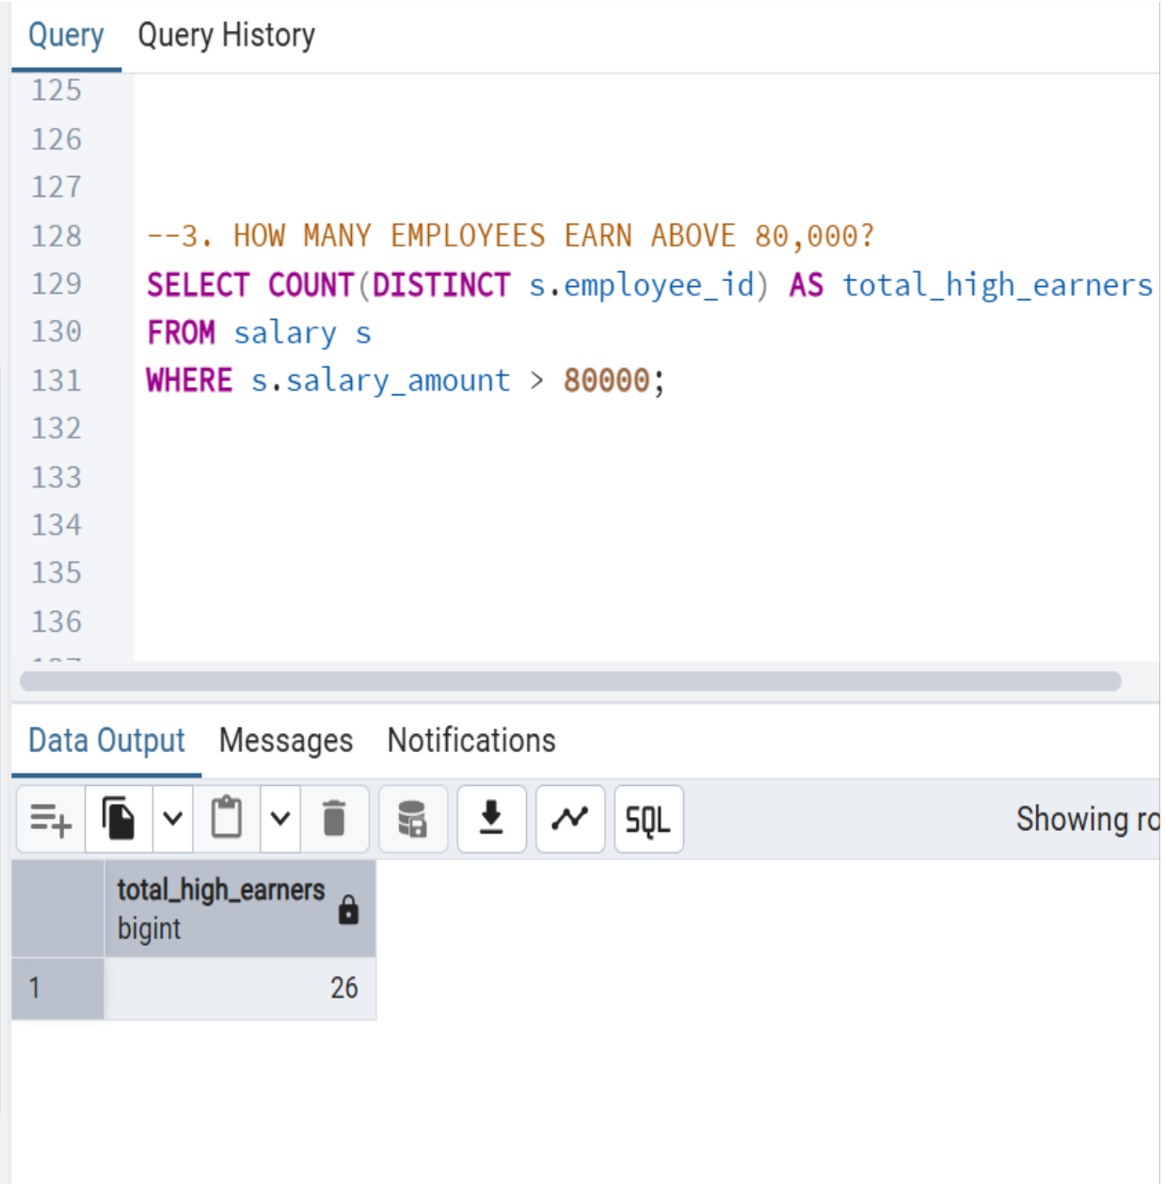
3. How many employees earn above
80,000?
Insights
Finding
s
• 26 employees (43.3%) earn above $80,000 annually
• This indicates a substantial investment in higher
compensated roles
Actionable Recommendations
• Develop higher earning growth opportunities for all
employees
18

Slide 19
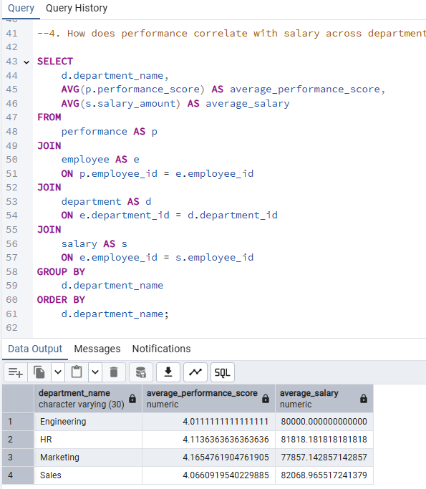
4. How does performance correlate with
salary across departments?
Insights
Findings
Engineering: This department has an average performance score of approximately 4.01 and an average salary of $80,000.
.HR: This department has a slightly higher average performance score of approximately 4.11 and an average salary of $81,818.18.
Marketing: This department has the highest average performance score at approximately 4.17 but a lower average salary compared to HR, at $77,857.14.
Sales: This department has the lowest average performance score at approximately 4.07 (note: the image shows 4.066, but the next digit is a 9, rounding up to 4.07) but the highest average salary at $82,068.96.
Actionable Recommendations
Conduct a salary audit and implement a performance-based bonus structure to retain top talent.
Conduct a salary audit and implement a performance-based bonus structure to retain top talent.
Implement a proactive retention strategy by conducting one-on-one reviews with high-performers to ensure their compensation and growth opportunities are meeting their expectations.
Establish a transparent compensation framework that clearly links performance to salary and promotions.
19

Slide 20
05
Conclusions
20

Slide 21
KEY INSIGHTS
• There is a substantial human capital investment with total annual salary expenses of $4,850,000 for 60
employees
• 43.3% of employees earn above 80,000 while 56.7% earn below, requiring equitable compensation policies
• Marketing shows a negative correlation (-0.07) between performance and salary, contributing to high
turnover (92.86)
• Engineering has the strongest (though generally weak) positive correlation (0.21), offering a model-for-pay
performance
• Sales related roles have the highest average salary
ACTIONABLERECOMMENDATIONSFORHR?
•
Conduct comprehensive exit/stay surveys/interviews to evaluate leadership, resources and compensation
•
Strengthen pay-for performance alignment and compensation equity across all department especially
marketing
•
Create clear career paths, while implementing targeted retention initiatives
•
Foster a positive work environment and improve work life balance
•
Build HR analytics platforms/dashboards to conduct regular monitoring and audits of compensation
packages
21

